Slide 1
Solo Project: Music Library Application
Ahmed Ibrahim

Slide 2
The Contents
Solo Project
ERD
Risk Assessment
CRUD functionality
Testing
Summary
Demo

Slide 3
Music Library Web App
The User will have the ability to register an account and update the details.
They will then be able to login and be directed to the Add a song Page
Now they can add a song of their choice.
It will then be added to the Playlist Page.
They can delete a song post if they wish.
They will also be able to logout.

Slide 4
Requirements
Trello Board
Relational Database
Documentation
Functional Python application
Testing
Front-end website using Flask
Integration with Version Control System
Deployed by CI Server

Slide 5
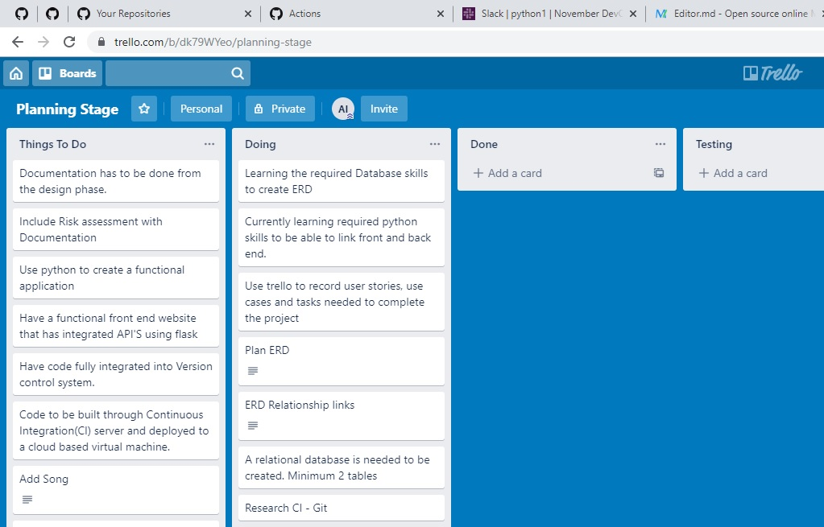
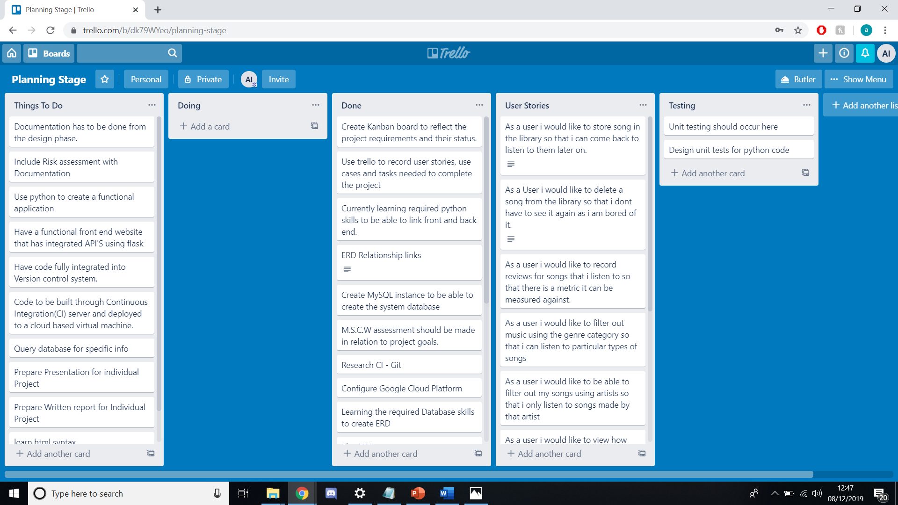
Planning - Trello

Slide 6
Technologies Used
Trello
Google Console Platform
Python
Flask
Version Control - Git
CI Server - Jenkins

Slide 7
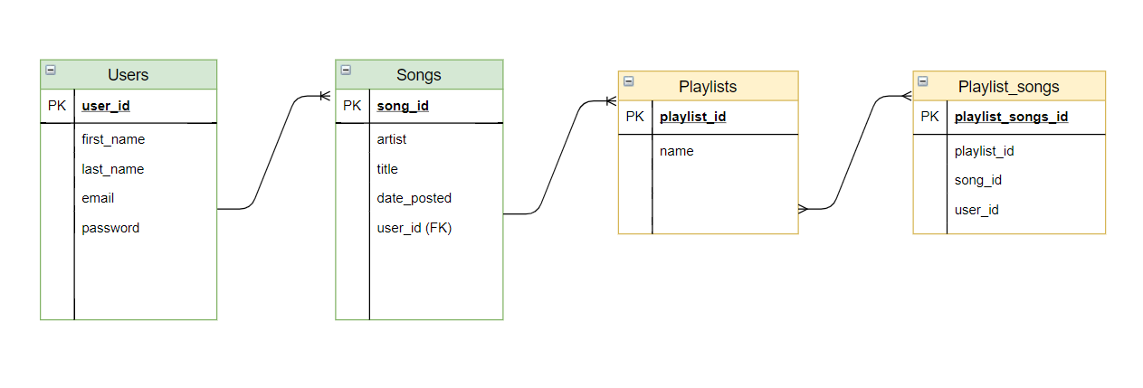
Entity Relationship Diagram (ERD)

Slide 8
User Stories
As a user i would like to store song in the library so that i can come back to listen to them later on.
As a User i would like to delete a song from the library so that i don't have to see it again as i am bored of it.

Slide 9
Risk Assessment
Poor Planning
With poor planning there may be a low likelihood of it occurring but if it happened then the impact would be very high to the project. Having poor planning would be a major danger to the project. So to combat this I used trello to make sure all requirements are down and all major goals are planned out.
Version Control
Having a version control system in place is essential to having a successful project. Working on different features and pushing the complete code up using git gives the project a high chance of succeeding. It's better than uploading all work at the last minute which could have massive bugs.

Slide 10
CRUD Functionality
Create
Read
Update
Delete

Slide 11
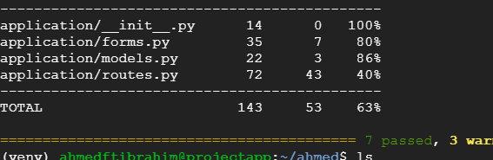
Testing
Unit Testing
TDD Test Driven Development Approach

Slide 12
Summary
What went well
CRUD Functionality
Unit Testing
Security
2 Table Database
Improvements for the future
Add Many to Many Relationship
Implement Full CI Pipeline
Improve Test Coverage Score

Slide 13
Demonstration
Jenkins
http://35.228.160.91:5000/home

Slide 14
Questions and Feedback
Thank you for listening

